Slide 1
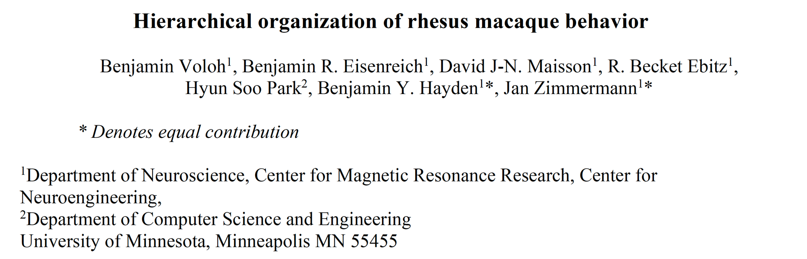
Neurobiology Lab Journal Club
Presented by: James Goodman
07. March 2022
Notes:
Today we're talking about a setup a lot of us are probably familiar with... from previous journal clubs, in fact.
But instead of focusing on the technical details of the recordings. themselves, we're focusing today on the behavioral analysis that comes from it.

Slide 2
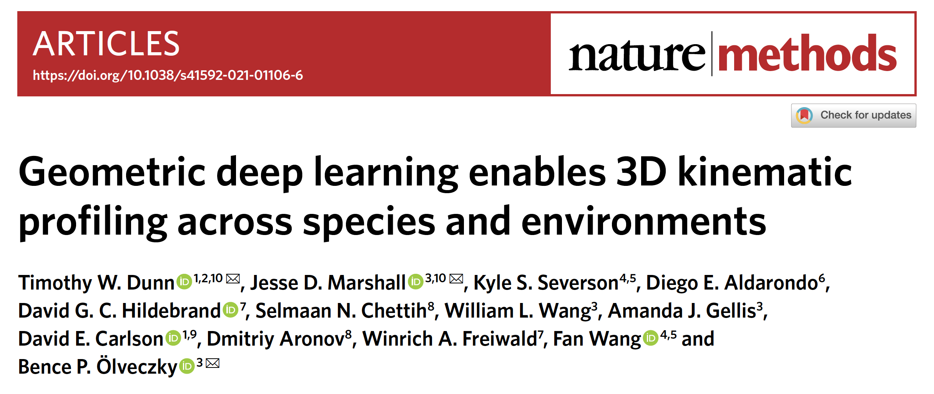
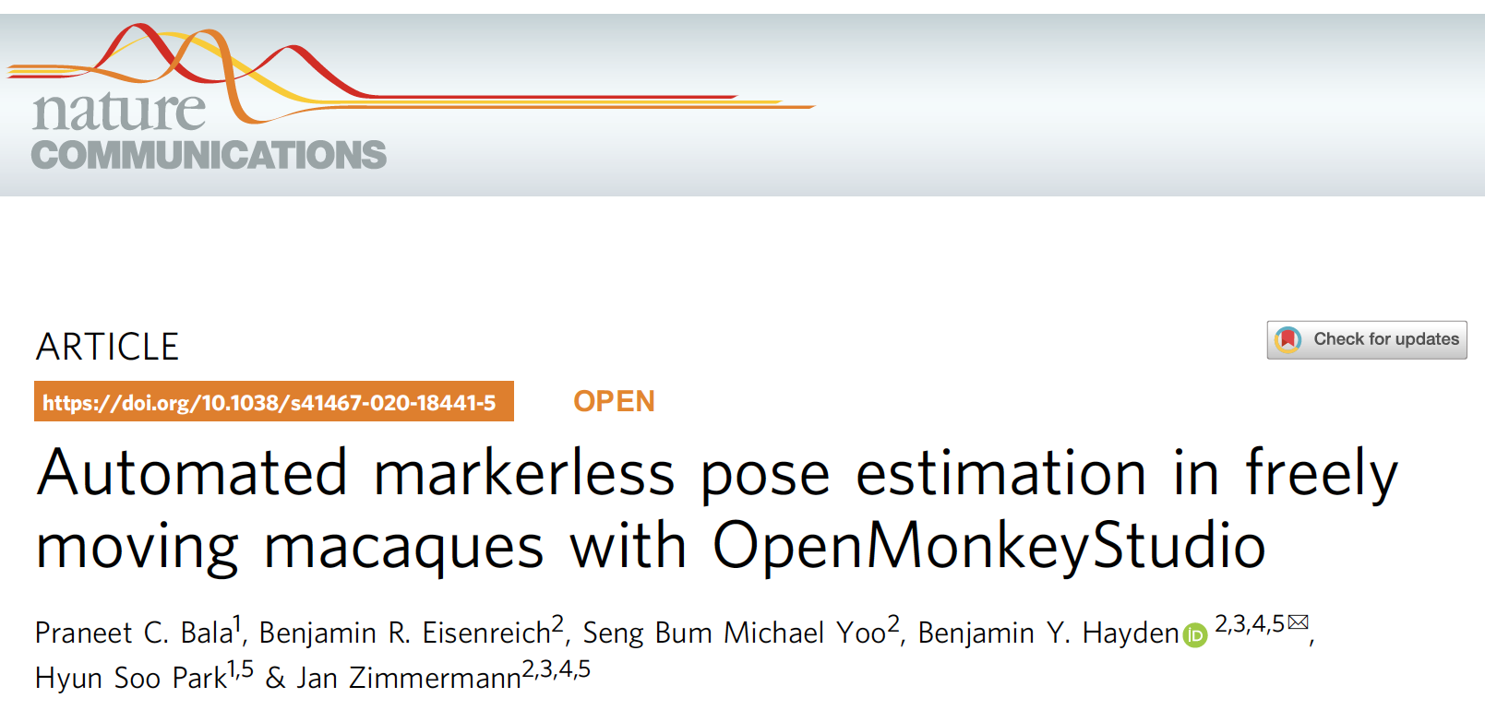
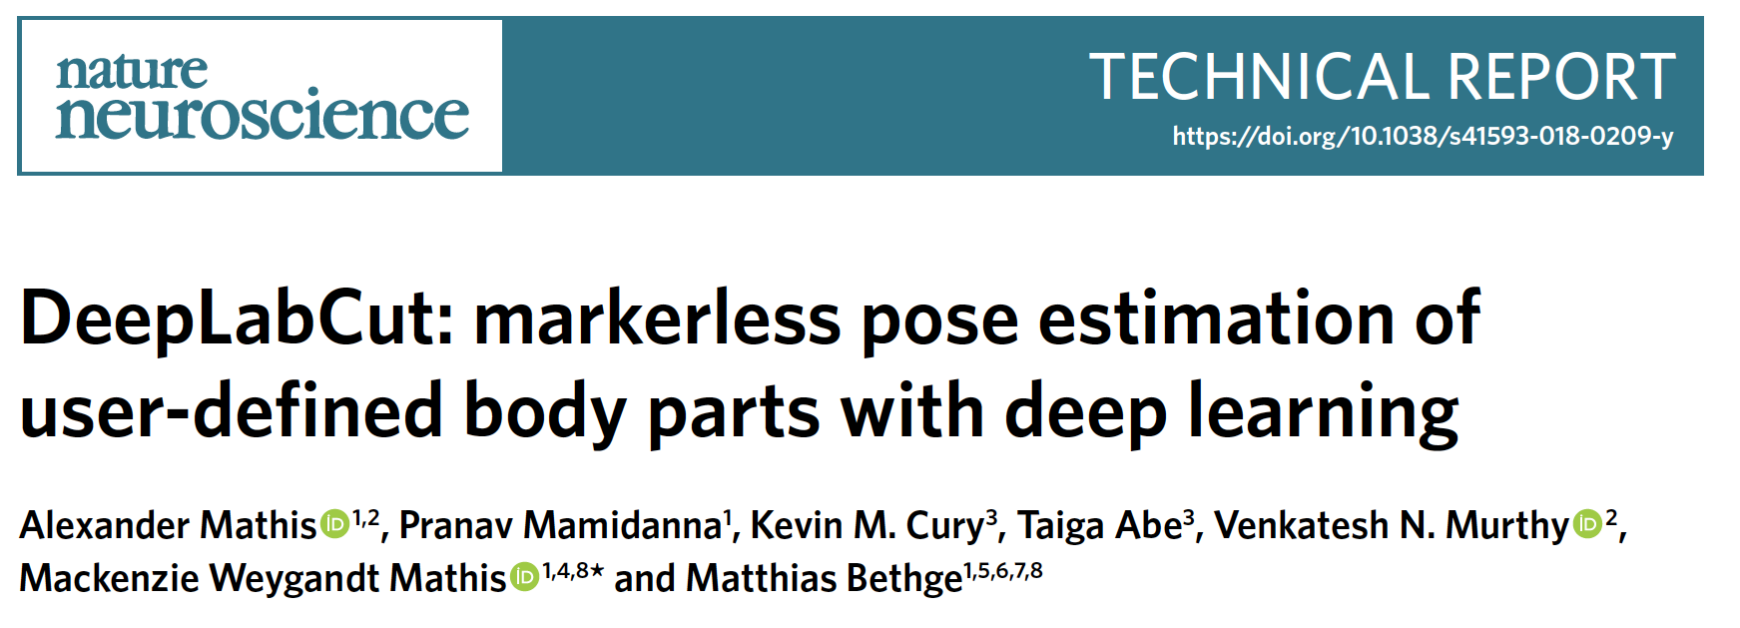
Optical Motion Tracking is Booming

Slide 3
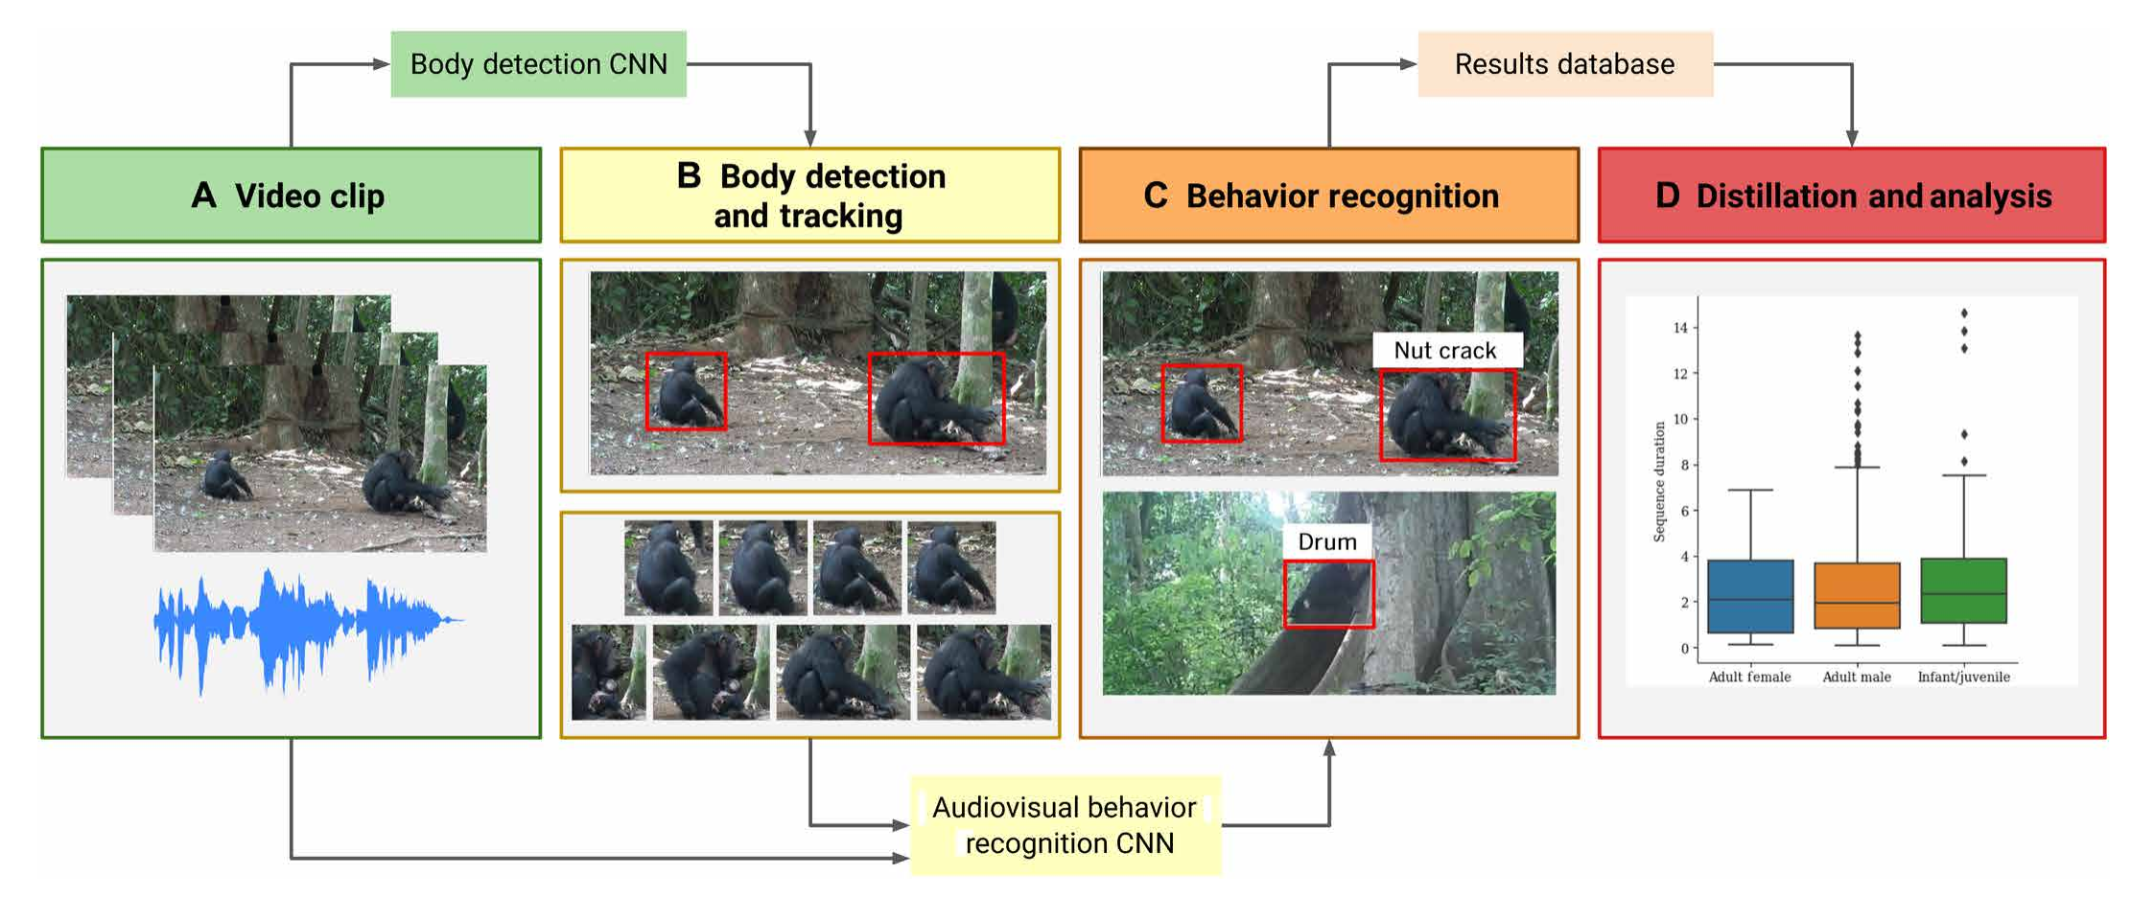
Toward the Automated Primate Ethogram (APE)
Bain et al. 2021 Sci. Advances

Slide 4
What do we hope to learn about?
An update on a very cool whole-body primate motion tracking platform
A deep dive into an unsupervised clustering framework for behavioral analysis
Within this framework, how many distinct behaviors are there?
A lower bound on the number of contexts a primate brain must flexibly manage?
Contrast with frameworks where behavior is traversal of a continuum

Slide 5
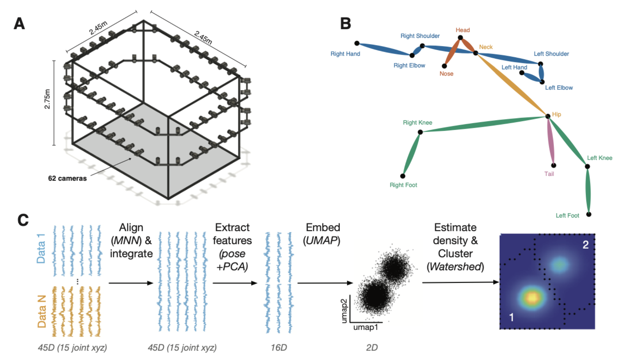
Tracking and Data Processing Methods
Notes:
2 monkeys – 1 with task experience, one naive
9 sessions per monkey
12 task-on (2 tasks, very similar: 1 is seek & pull levers of juice dispensers with either predictable or somewhat random reward schedules)
6 task-off (no juice dispensers)
2.45 x 2.45 x 2.75 m cage
31.4 hours, or 3.3 million frames
===
UMAP: the geometry is frankly a bit above my head
BUT
think of it like maximizing the cross-entropy between edge weights in the low-D embedding and the high-D source space, where those edge weights have been normalized via soft(arg)max to soft-adjacency values
===
MNN:
Mutual-nearest-neighbors registration across sessions
It’s basically how you get rid of a session-specific effect if the overall session mean is confounded by different sets of postures being expressed across sessions.
Essentially, you find the postures that are similar across sessions by determining if they are mutual nearest (cross) neighbors, then compute the mean vector separating these mutual nearest neighbor pairs.

Slide 6
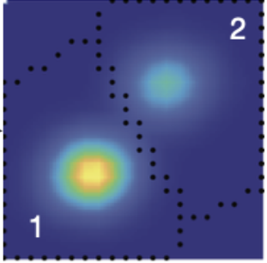
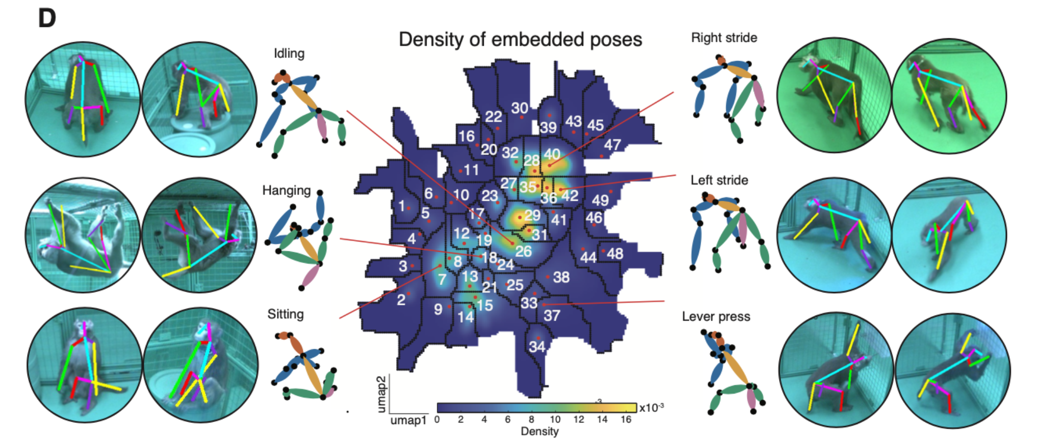
Watershed algorithm reveals 49 distinct postures

Slide 7
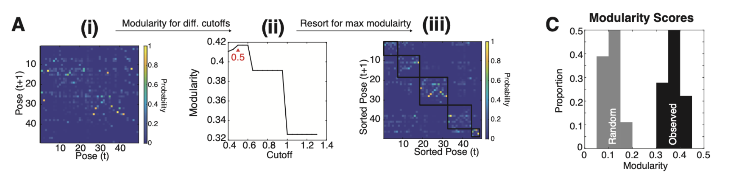
These postures show modular organization in their transitions
Notes:
"Paris" hierarchical clustering algorithm – equivalent to a multi-resolution version of Louvain clustering (Louvain has a resolution parameter, by the way)
Shown here is an example from a single task-off session
Bonald, T., Charpentier, B., Galland, A., & Hollocou, A. (2018). Hierarchical graph clustering using node pair sampling. arXiv preprint arXiv:1806.01664.

Slide 8
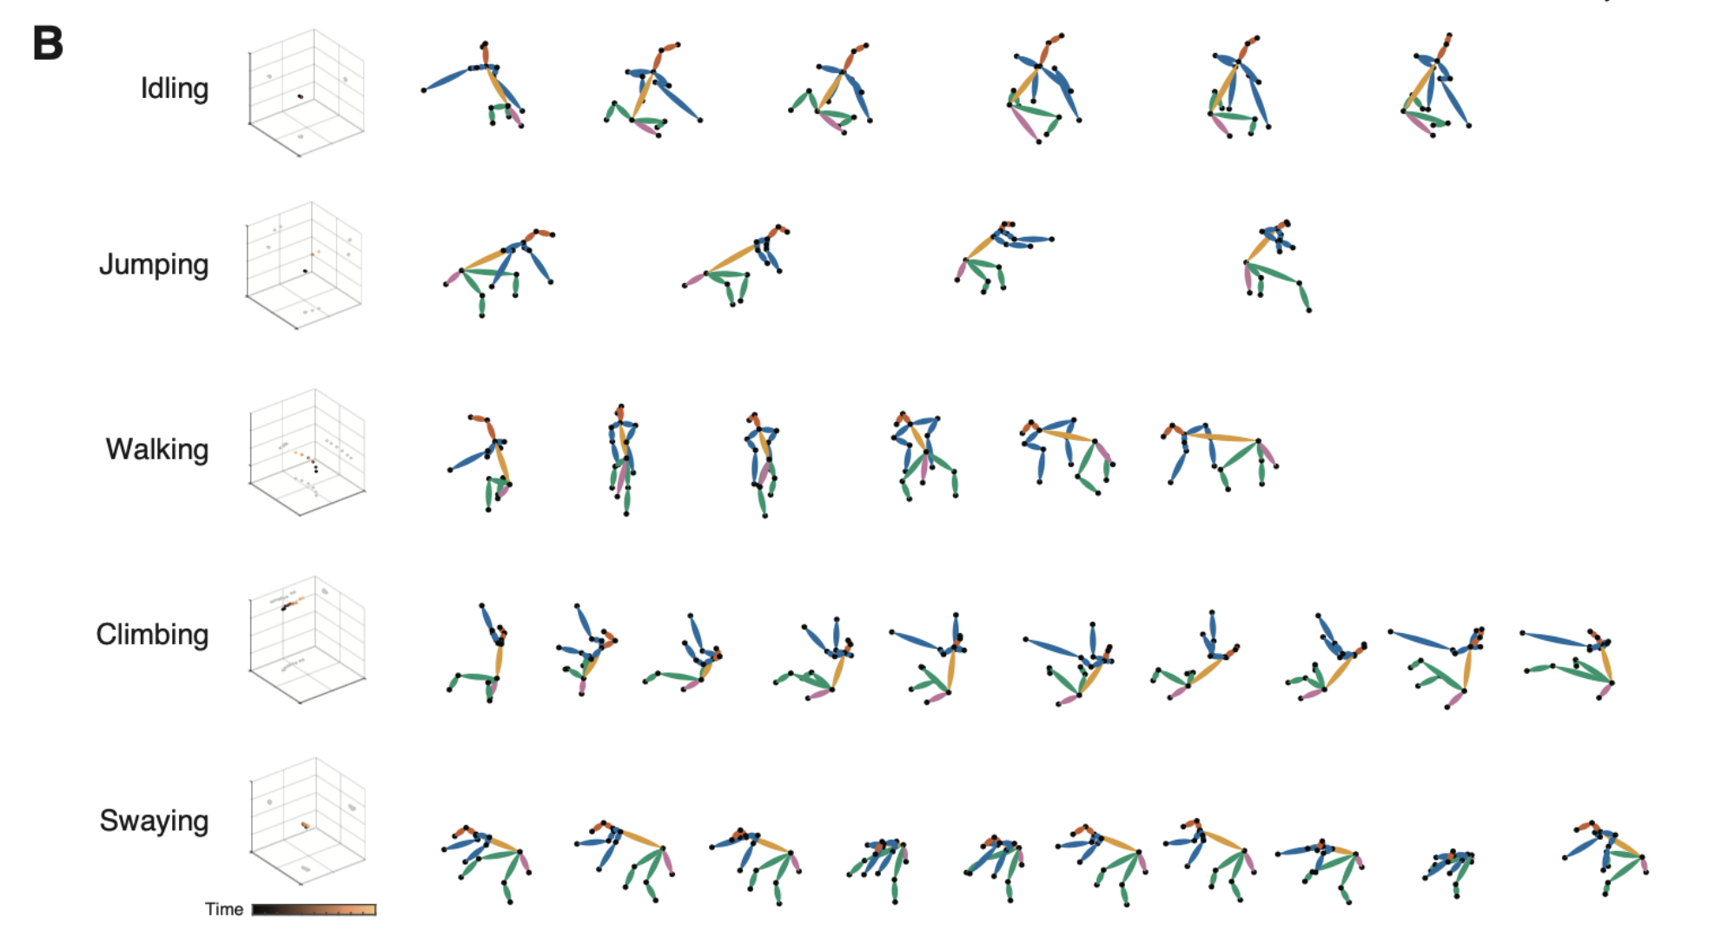
Modules correspond to intuitive semantic groups

Slide 9
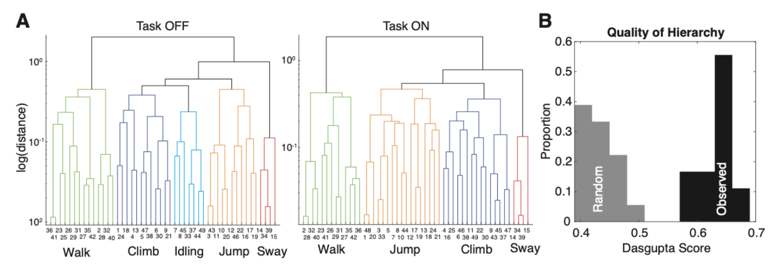
Postural modules are further hierarchically organized in their transitions
Notes:
Dasgupta score = size of the smallest possible hierarchical cluster containing two nodes times the weight (similarity, or here, transition probability) of the edge between them
basically, a good clustering should make sure that nodes with strong edges connecting them are clustered together even at very low resolutions
consider the case of 2ab vs. a² + b². If a > b > 1, then the RHS is always gonna be greater.
Task OFF = free exploration, no juice feeders available
Task ON = controlled depletion task or random depletion task (juice feeders available)
For both the controlled and random depletion tasks, each feeder was programmed to deliver a specific reward size on pressing of a lever; it started high and decreased by a specified amount. In the controlled condition each feeder delivered a base reward consisting of an initial 2 mL of juice that decreased by 0.125 mL with each subsequent delivery (turn). In the random condition, feeder depletion rates were the same as the controlled depletion condition. However, feeders randomly increased or decreased the juice delivery amount by 1 mL in addition to the base reward schedule at a probability of 50%. Both feeder types delivered rewards following their respective schedules until reaching the base value of 0, at which point the patch was depleted and no more rewards were delivered.

Slide 10
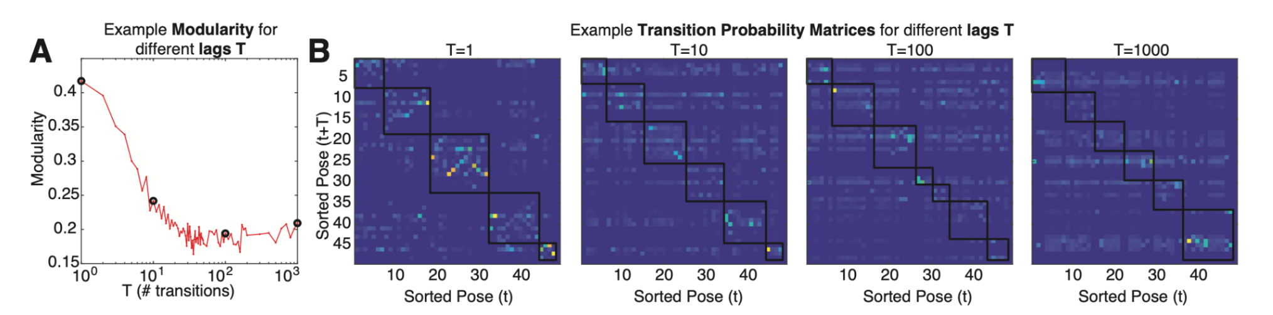
Postural clusters are stable over multiple values of a transition lag parameter
Notes:
30 Hz between samples
So 100 lags = 3.33 seconds

Slide 11
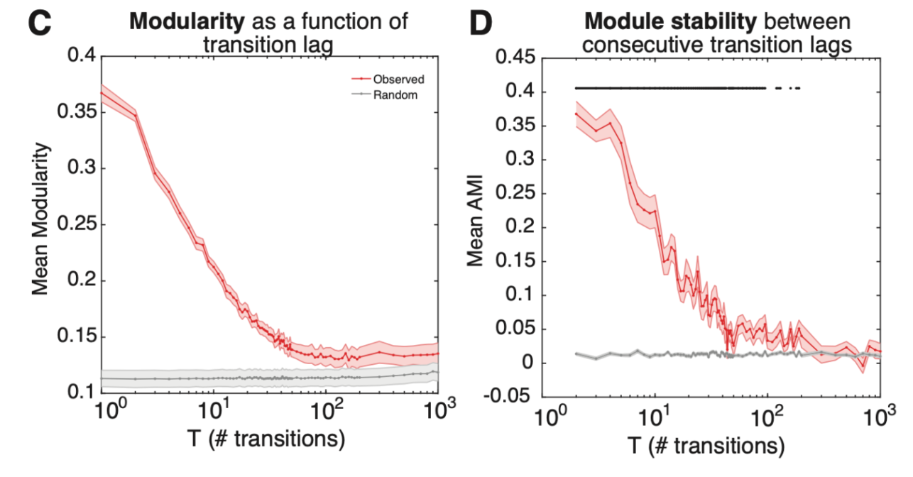
Postural clusters persist even when considering long (>3s) transition periods
Notes:
AMI = adjusted mutual information score
ami.m: https://www.mathworks.com/matlabcentral/fileexchange/33144-the-adjusted-mutual-information
the idea is you're looking for mutual information about one set of clusterings on a dataset given another set of clusterings
(in this case, across different time lags. important is that the clusterings are paired by dataset, though!)
Formula for AMI:
AMI(U, V) = [MI(U, V) - E(MI(U, V))] / [avg(H(U), H(V)) - E(MI(U, V))]
(https://scikit-learn.org/stable/modules/generated/sklearn.metrics.adjusted_mutual_info_score.html)
The idea is you're normalizing by the total entropy present in your clustering (which tends to go up trivially as a function of the number of clusters you keep). It's basically information theoretic R-squared (i.e., where the foundational loss metric is Shannon entropy rather than variance)
These figures are averaged across all trials from each animal (I assume animals are actually pooled here)
9 sessions per monkey
12 task-on
6 task-off

Slide 12
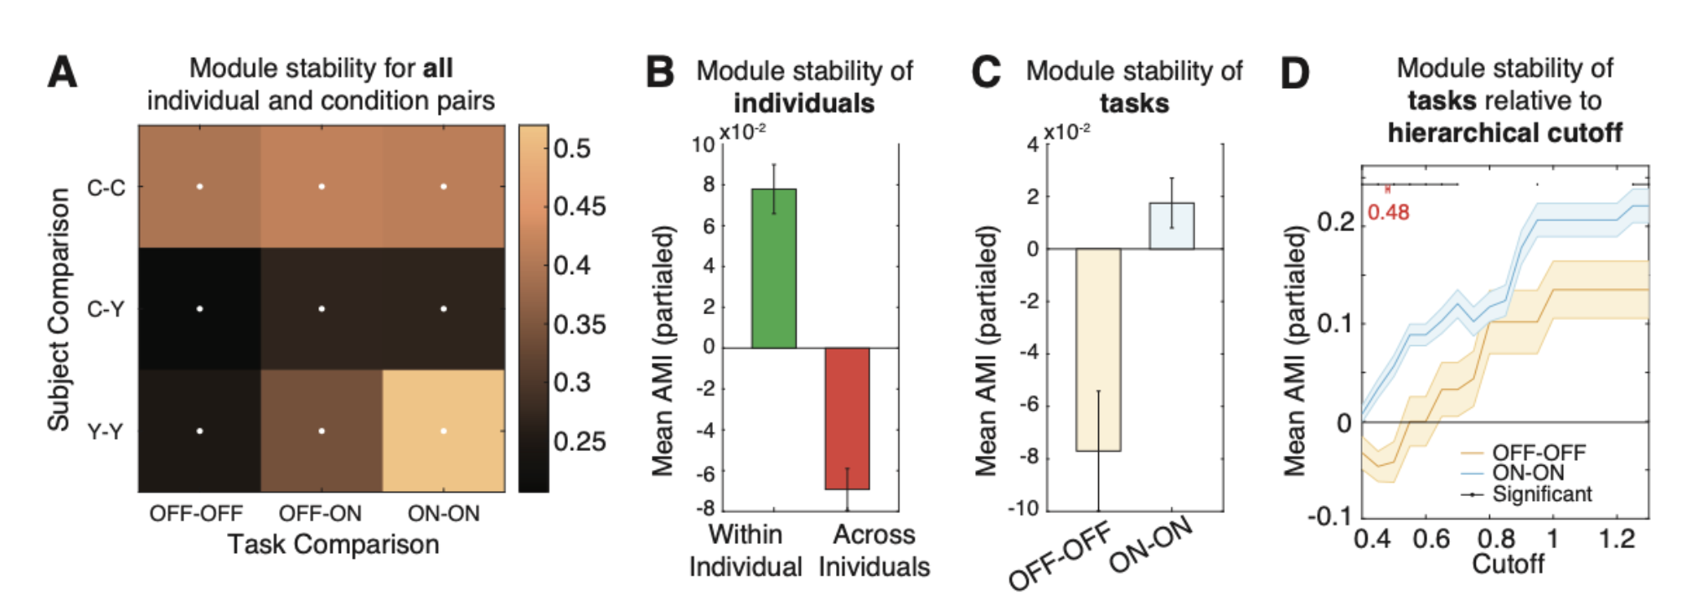
Behavioral modularity is partially subject- and task-specific

Slide 13
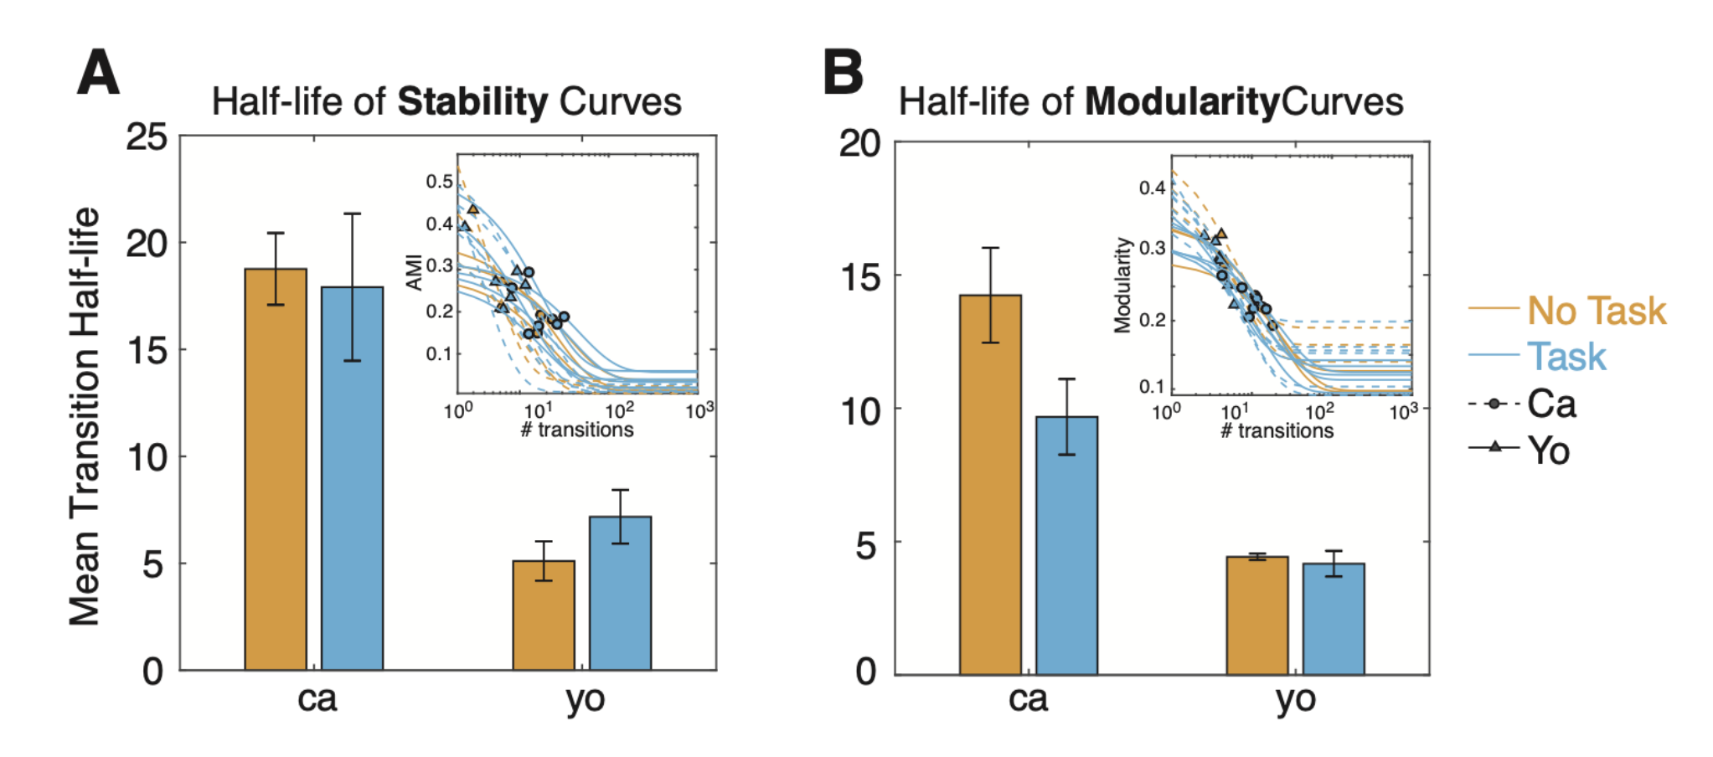
Subject-, but not task-, specific differences in terms of fundamental timescale of transitions
Notes:
individual sessions being plotted in the insets

Slide 14
Discussion points
Our method is pretty cool (and it is!)
Individual- and task-specific effects
Specifications of our model that we think are important
We use kinematic information on the timescale of poses and postures
We perform clustering on the basis of Markovian state (posture) transitions
We use a totally unsupervised method, although supervised methods could wrangle the data to better fit priors
Environmental demands (i.e., specific tasks) give rise to behavioral stabilization
Perhaps fewer actions are present in the repertoire under pressure
Perhaps there is just less variability within those action clusters
Automated ethogramming would be pretty rad

Slide 15
Compare and contrast with continuous framework
Both involve low-dimensional manifolds
In this paper & the practice of ethogramming, one seeks behavioral "modules"
In "synergies" framework, behaviors define a continuum without hard boundaries
Think Napier's observations on power & precision grips, the proto-synergies
Within these broader categories, there was a continuum of aperture sizes
There were also tasks such as rope tying with hybrid power-precision grips
Grand unified hierarchical framework?
At coarse resolution, behavior is modular
At a fine enough resolution, behavior spans a continuum
Perhaps a similar reckoning to be had between "flexible" vs. "rule-based" motor learning

Slide 16
Forget frameworks, what did we learn about behavior per se?
Not a lot, frankly
That there’s individual variation? Yeah, of course there is.
That “context constrains behavioral expressivity”? Yes, there are stereotyped behaviors.
That there are 49 fundamental postures? I don’t think anyone would buy that, not even the authors. It all depends on the level of granularity one deems useful!
The “findings” are simply not all that surprising
But that’s kind of the point
To sell an automated behavioral analysis framework, you need to re-demonstrate your ground truth

Slide 17
End
Questions?

Slide 18
Supplements

Slide 19
Tracking and Data Processing Methods

Slide 20
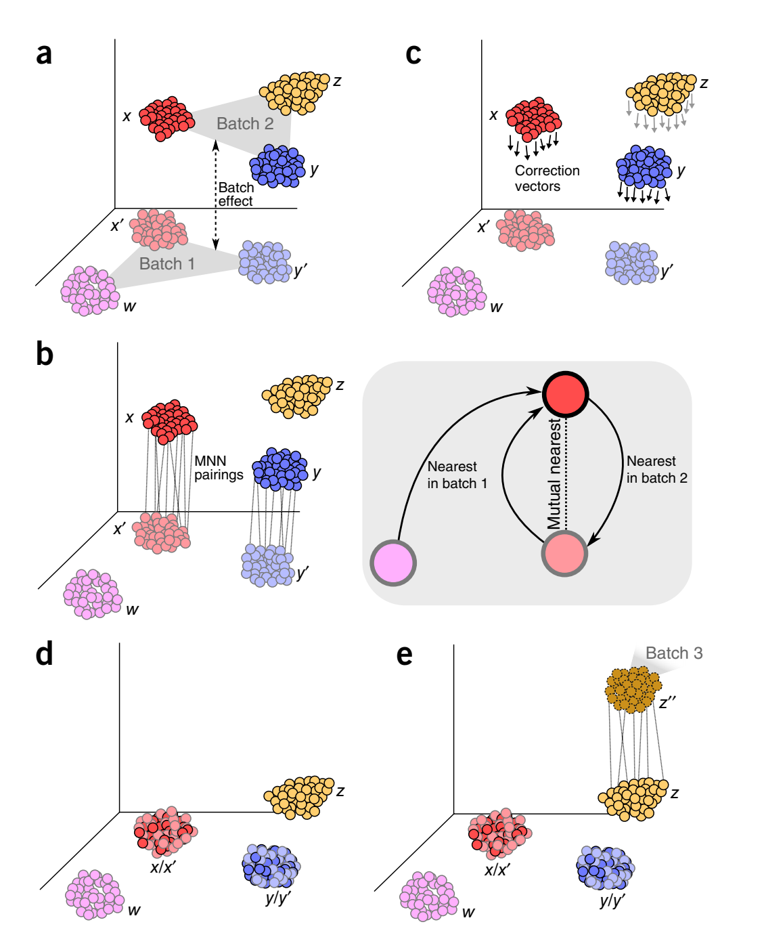
MNN: Mutual Nearest Neighbors
Haghverdi et al. 2018 Nature Biotechnology

Slide 21
Tracking and Data Processing Methods
Notes:
UMAP: the geometry is frankly a bit above my head
BUT
think of it like maximizing the cross-entropy between edge weights in the low-D embedding and the high-D source space, where those edge weights have been normalized via soft(arg)max to soft-adjacency values
There seem to be additional bells & whistles, but this seems to be the meat & potatoes of it

